Slide 1
Introduction to Programming with Python
Ramesh yajjala, Assistant professor(c)
Dept. Of Computer Science And Engineering
RGUKT-IIIT Srikakuam

Slide 2
You will learn………. 1.Introduction to python 2.features of Python 3.Applications of Python 4.History of Python 5.How to install python 6.How to execute python 6.1.Interactive Shell Mode 6.2.Script Mode

Slide 3
Introduction to Python
What is Python?
Python is a cross-platform programming language, meaning, it runs on multiple platforms like Windows, Linux, Unix and has even been ported to the Java and .NET virtual machines. It is free and open source.
Python is a popular programming language. It was created in 1991 by Guido van Rossum.
It is used for:
web development (server-side),
software development,
mathematics,
system scripting.

Slide 4
1) Easy to Learn and Use 2) Expressive Language 3) Interpreted Language 4) Cross-platform Language 5) Free and Open Source 6) Object-Oriented Language 7) Extensible 8) Large Standard Library 9) GUI Programming Support 10) Integrated
Features of Python

Slide 5
1) Easy to Learn and Use
Python is easy to learn and use. It is developer-friendly and high level programming language
2) Expressive Language
Python language is more expressive means that it is more understandable and readable
3) Interpreted Language
Python is an interpreted language i.e. interpreter executes the code line by line at a time. This makes debugging easy and thus suitable for beginners
4) Cross-platform Language
Python can run equally on different platforms such as Windows, Linux, Unix and Macintosh etc. So, we can say that Python is a portable language

Slide 6
5) Free and Open Source
Python language is freely available at offical web address www.python.org.The source-code is also available. Therefore it is open source.
6) Object-Oriented Language
Python supports object oriented language and concepts of classes and objects come into existence
7) Extensible
It implies that other languages such as C/C++ can be used to compile the code and thus it can be used further in our python code.

Slide 7
8) Large Standard Library
Python has a large and broad library and prvides rich set of module and functions for rapid application development.
9) GUI Programming Support
Graphical user interfaces can be developed using Python.
10) Integrated
It can be easily integrated with languages like C, C++, JAVA etc.

Slide 8
Python is known for its general purpose nature that makes it applicable in almost each domain of software development. Python as a whole can be used in any sphere of development. Here, we are specifying applications areas where python can be applied.
Applications of Python

Slide 9
1) Web Applications 2) Desktop GUI Applications 3) Software Development 4) Scientific and Numeric 5) Business Applications 6) Console Based Application 7) Audio or Video based Applications 8) 3D CAD Applications 9) Enterprise Applications 10) Applications for Images
Python Applications Area(Applications of Python)

Slide 10
1) Web Applications
We can use Python to develop web applications. It provides libraries to handle internet protocols such as HTML and XML, JSON, Email processing, request, beautifulSoup(Beautiful Soup is a Python package for parsing HTML and XML documents ), Feedparser etc. It also provides Frameworks such as Django(Django is a free and open-source web framework, written in Python, which follows the model-view-template (MVT) architectural pattern), Pyramid, etc… to design and develelop web based applications.
2) Desktop GUI Applications
Python provides Tk GUI library to develop user interface in python based application. Some other useful toolkits wxWidgets(wxWidgets is a widget toolkit and tools library for creating graphical user interfaces for cross-platform applications.), Kivy, pyqt that are useable on several platforms. The Kivy is popular for writing multitouch applications.
3) Software Development
Python is helpful for software development process. It works as a support language and can be used for build control and management, testing etc.

Slide 11
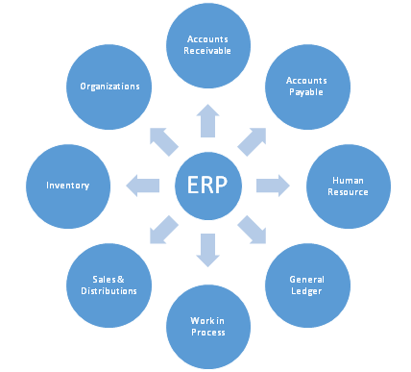
4) Scientific and Numeric
Python is popular and widely used in scientific and numeric computing. Some useful library and package are SciPy, Pandas, IPython etc. SciPy is group of packages of engineering, science and mathematics.
5) Business Applications
Python is used to build Bussiness applications like ERP(Enterprise Resourse Planning) and e-commerce systems.

Slide 12
6) Console Based Application
We can use Python to develop console based applications. For example: IPython.
7) Audio or Video based Applications
Python is awesome to perform multiple tasks and can be used to develop multimedia applications. Some of real applications are: TimPlayer(Play, modified handling of songs which uses jumps & breaks to play a pattern ... Provided helpers for sound modules emulated with the help of TimPlayer), cplay(cPlay delivers high quality audio playback) etc.

Slide 13
8) 3D CAD Applications
To create CAD application Fandango is a real application which provides full features of CAD.
9) Enterprise Applications
Python can be used to create applications which can be used within an Enterprise or an Organization. Some real time applications are: OpenErp, Tryton, Picalo etc.
10) Applications for Images
Using Python several application can be developed for image. Applications developed are: VPython, Gogh, imgSeek etc.
There are several such applications which can be developed using Python

Slide 14
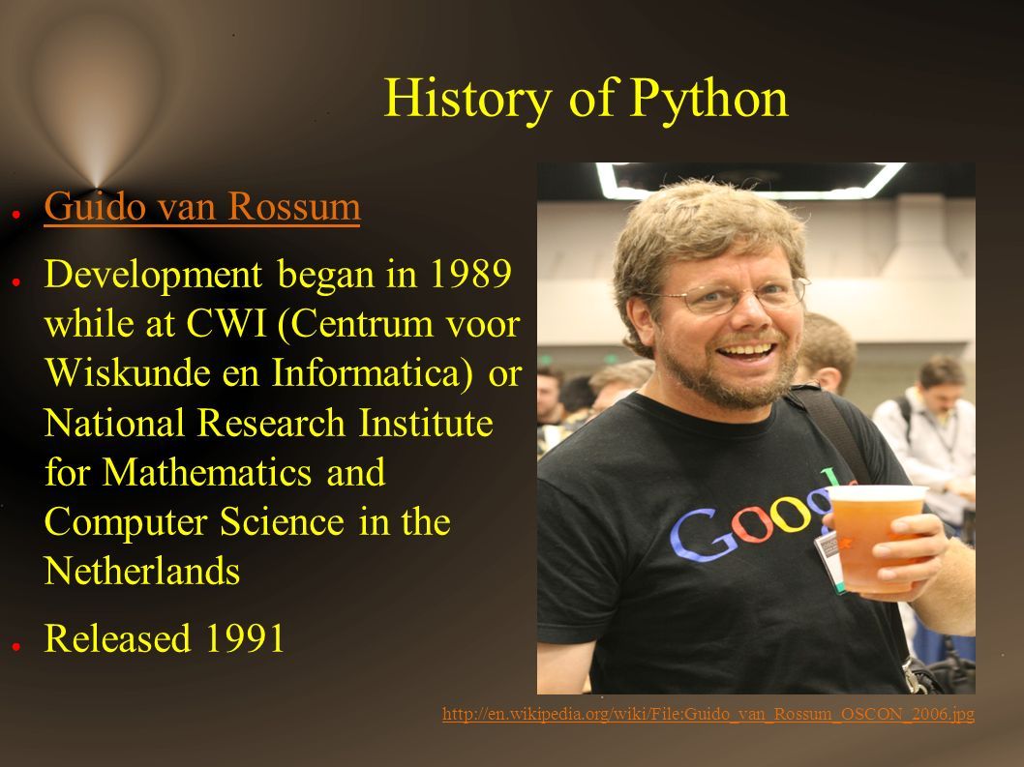
History of Python

Slide 15
HOW TO INSTALL PYTHON
To start with Python, first make sure that the Python is installed on local computer.
To install Python, visit the official site and download Python from the download section.
To install Python, firstly download the Python distribution from www.python.org/download.
Step One

Slide 16
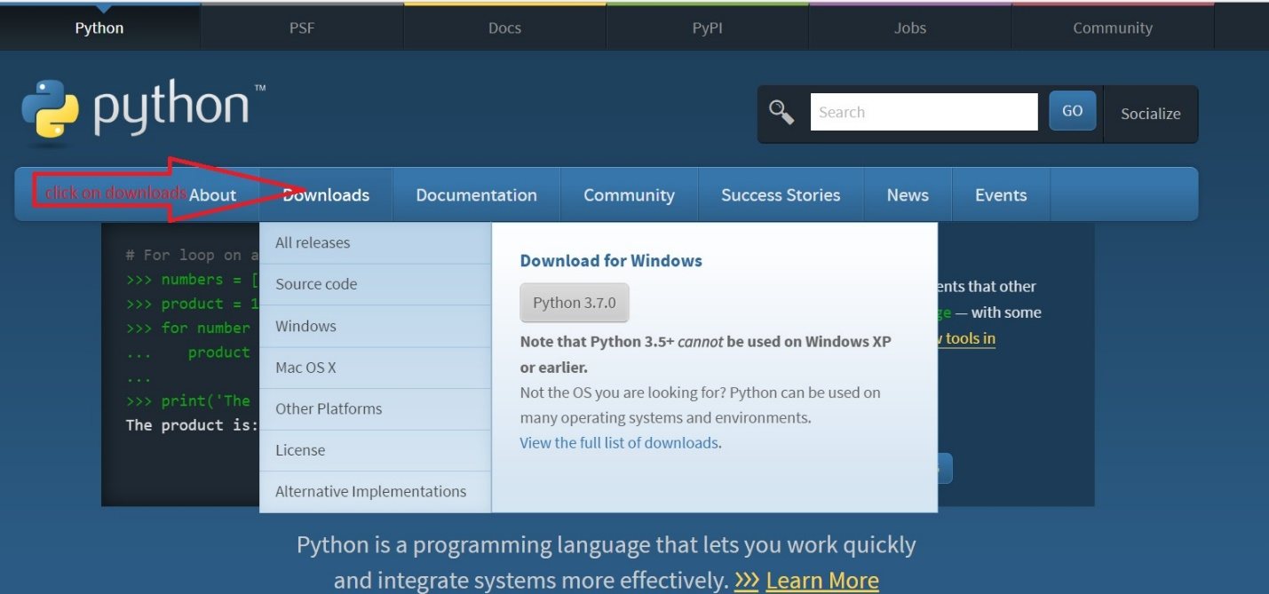
Step Two

Slide 17
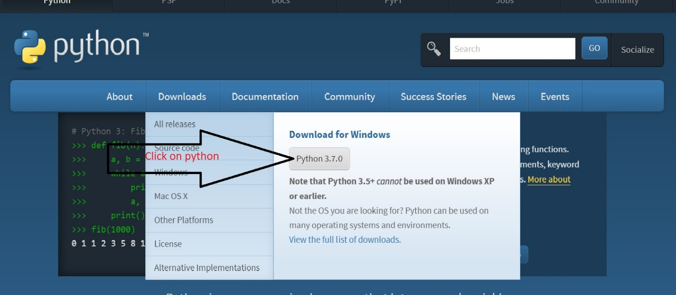
Step Three

Slide 18
How to execute python Code
To execute Python code, we can use any approach that are given below.
1)Interactive Shell Mode
2) Script Mode

Slide 19
1) Interactive Shell Mode
Python provides Interactive Shell to execute code immediately and produce output instantly. To get into this shell, write python in the command prompt and start working with Python.
Python Example using Interactive Shell
Python interactive shell is used to test the code immediately and does not require to write and save code in file.

Slide 20
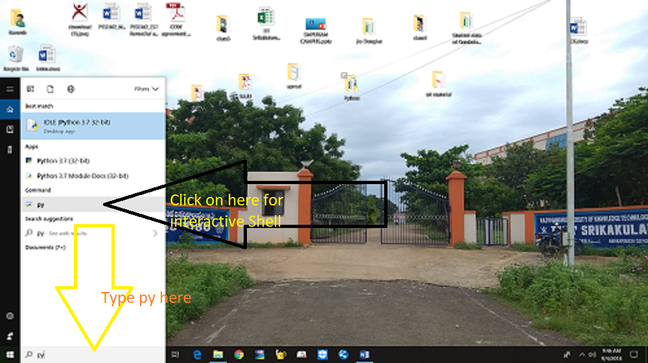
Step1:Type py in Search for interactive shell

Slide 21
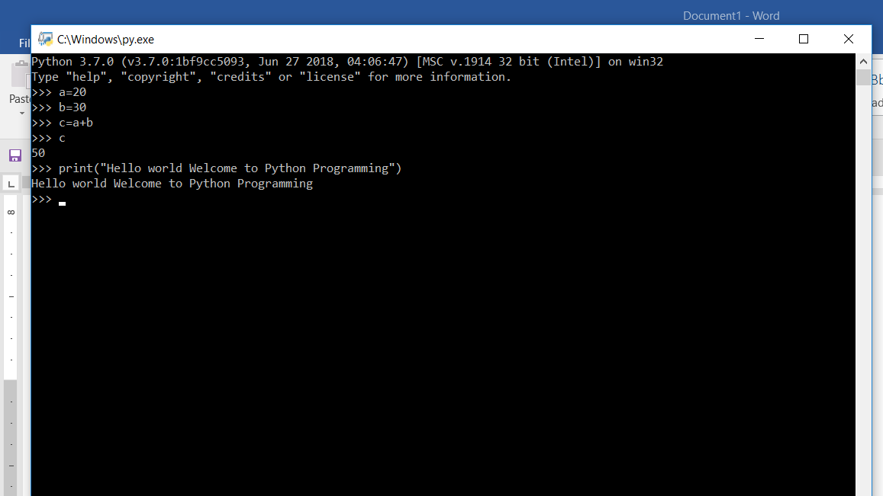
Step2:You Will get the Interactive Shell

Slide 22
2) Script Mode
Using Script Mode, we can write our Python code in a separate file of any editor in our Operating System.
IDLE (short for integrated development environment or integrated development and learning environment) is an integrated development environment for Python, which has been bundled with the default implementation of the language.

Slide 23
Python Example for script mode
Python is easy to learn and code and can be execute with python interpreter. We can also use Python interactive shell to test python code immediately.
A simple hello world example is given below. Write below code in a file and save with .py extension. Python source file has .py extension.

Slide 24
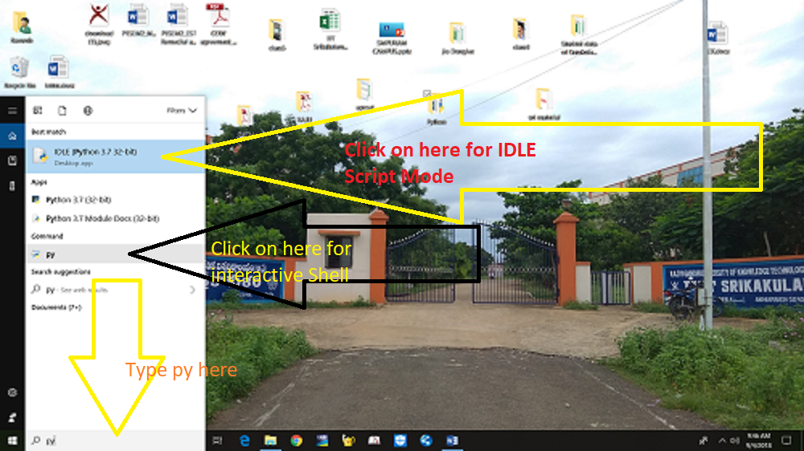
Step1: Click on IDLE for script mode

Slide 25
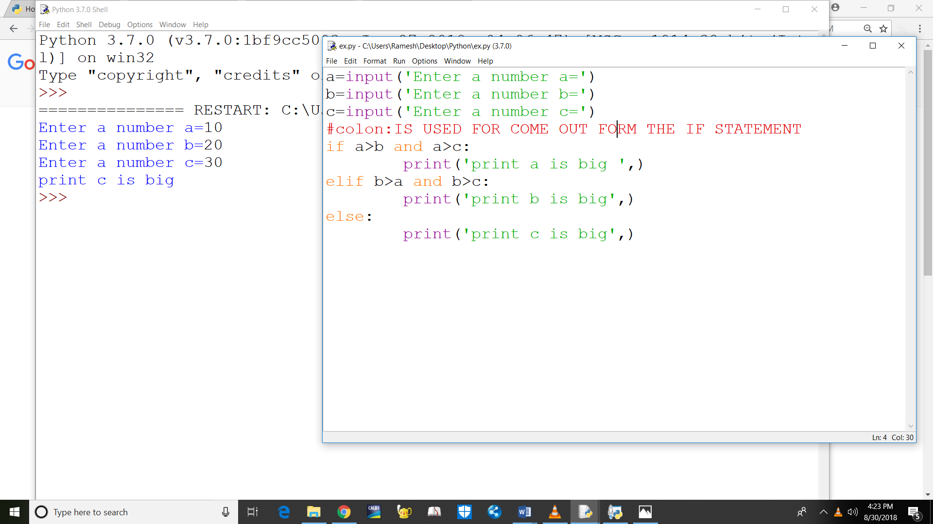
Step2:Go to file Step3:Select New Step4:Save as file name.py Step5:run the code click on run module

Slide 26
Thank You
RGUKT-IIIT SRIKAKULAM

